Slide 1
Android
Android Architecture and Studio installation
Dr.K.Sathiyamurthy
Department of CSE, PTU

Slide 2
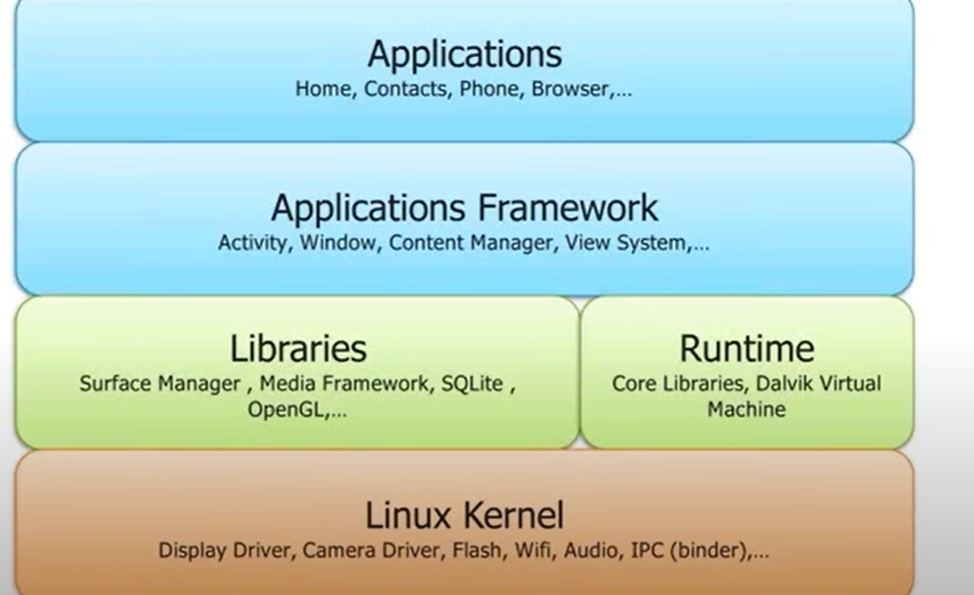
Android architecture

Slide 3
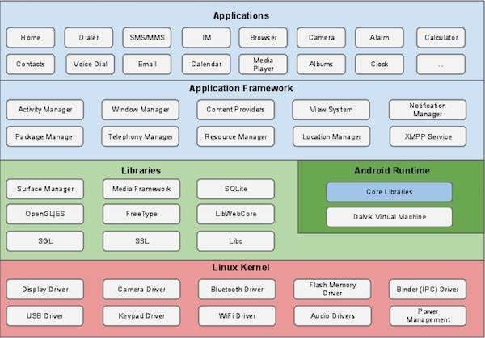

Slide 4
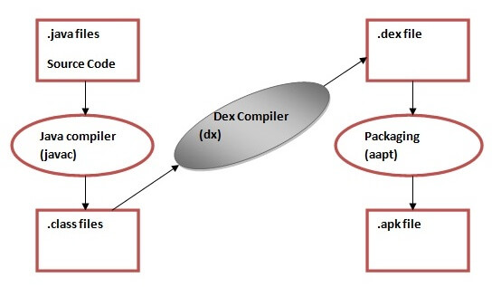

Slide 5


Slide 6
Android studio ide
Based on IntelliJ IDEA
FREE
Wide variety of android specific features

Slide 7
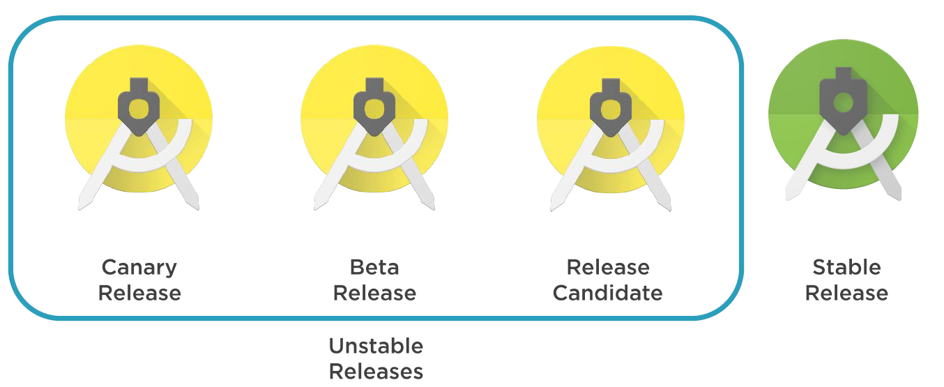
Release types

Slide 8
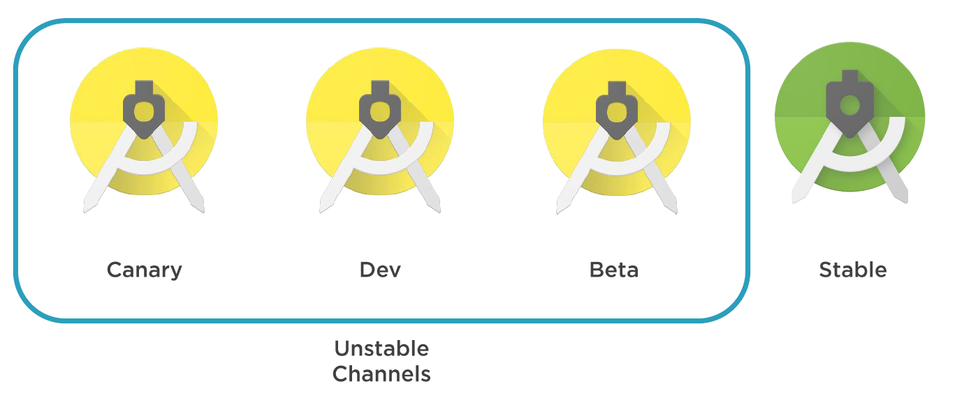
Release channels

Slide 9
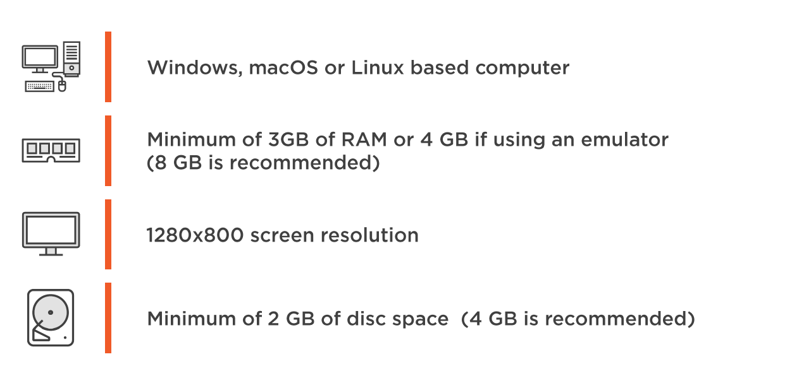
System requirements

Slide 10
downloading
https://developer.android.com/studio
Check the latest system requirements
Check the latest features
Download Android Studio

Slide 11
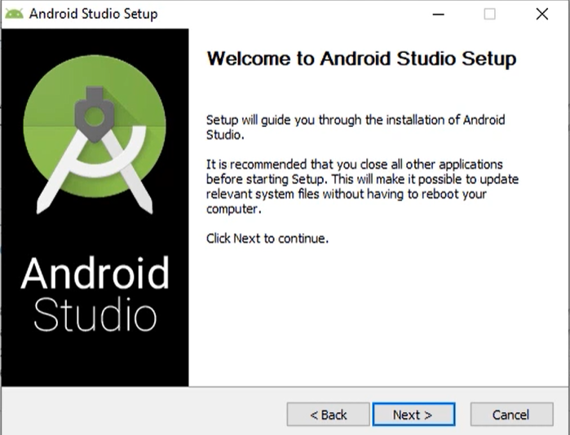

Slide 12
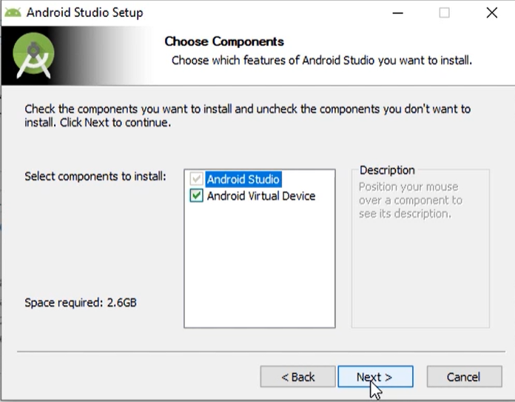

Slide 13
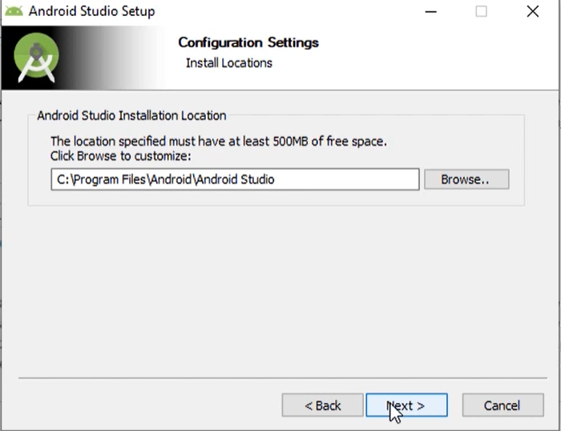

Slide 14
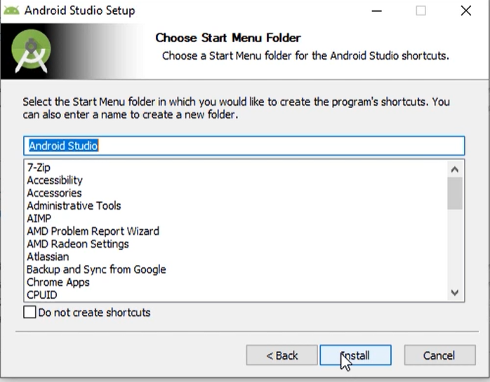

Slide 15
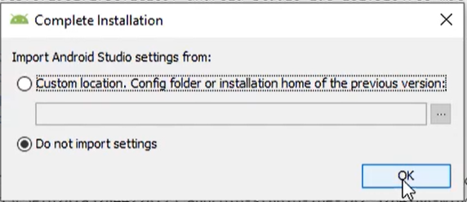

Slide 16
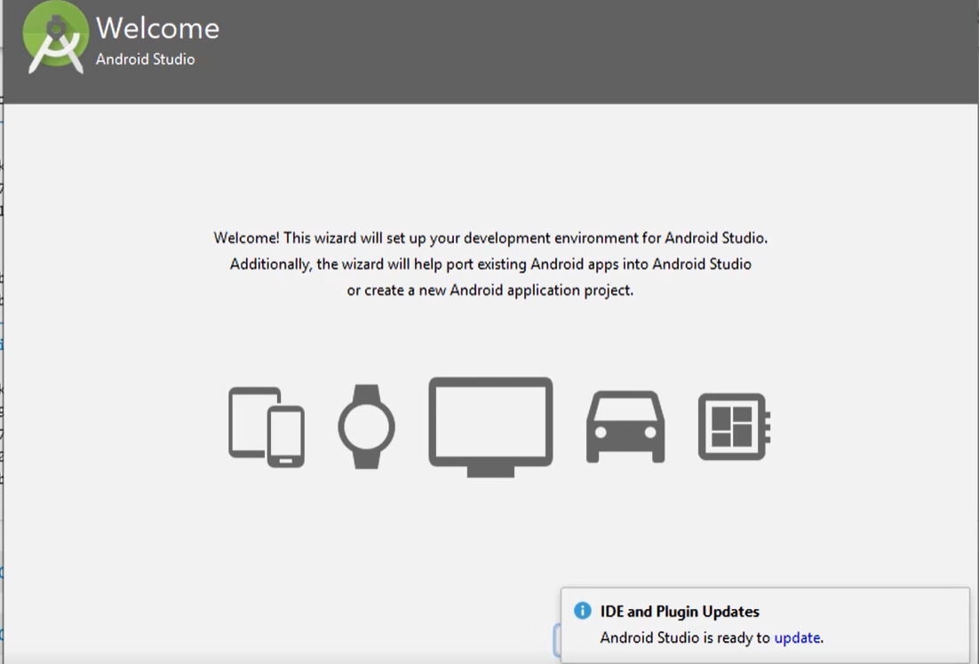

Slide 17
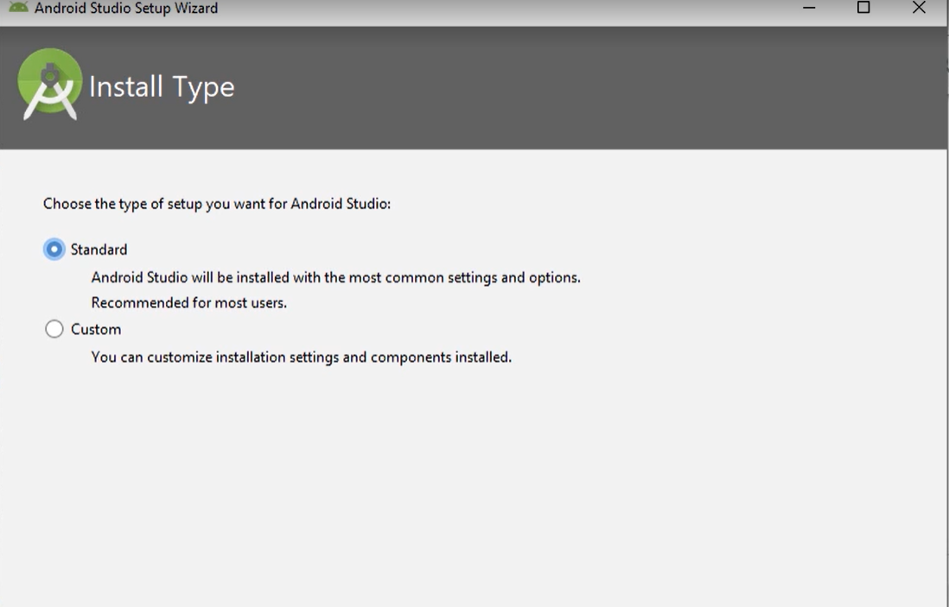

Slide 18
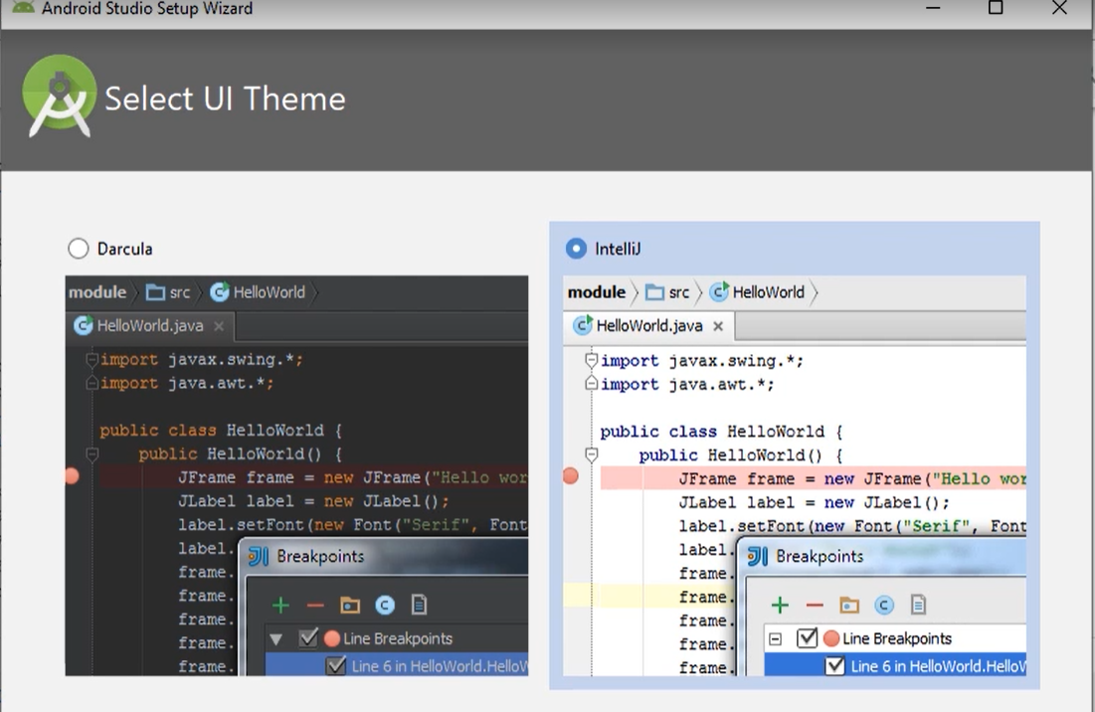

Slide 19
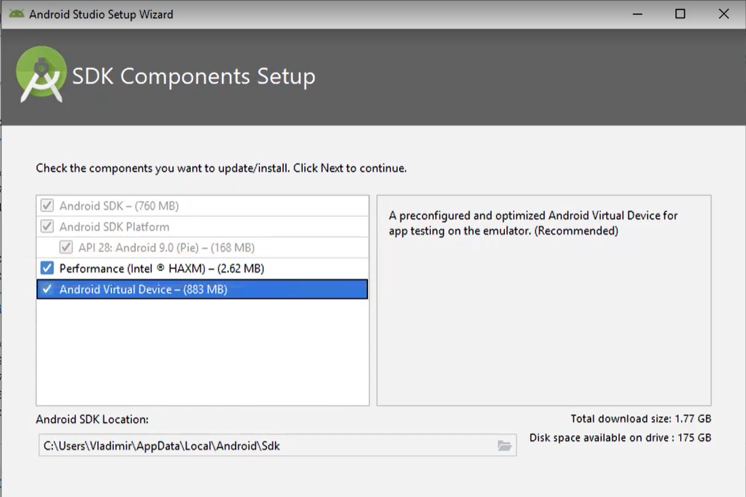

Slide 20
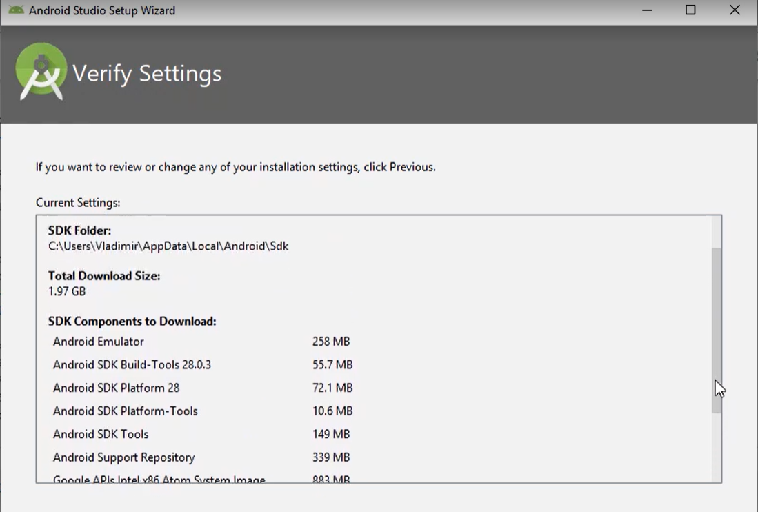

Slide 21
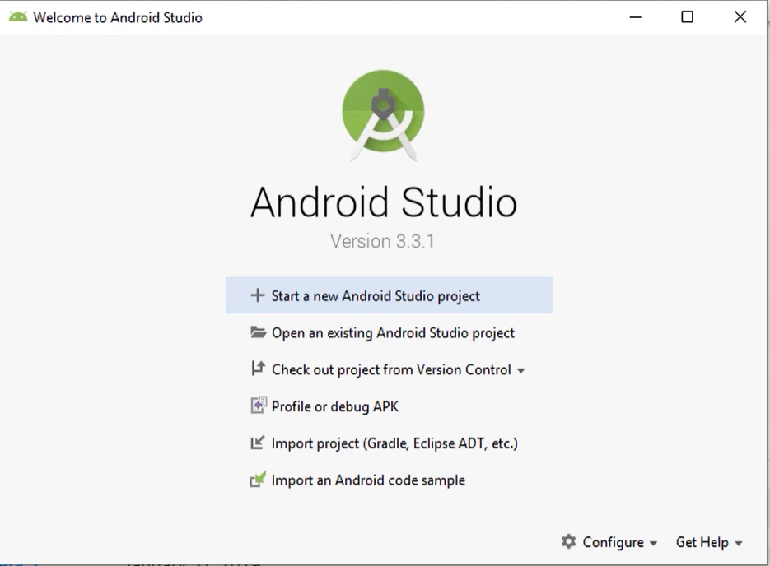

Slide 22
Installation on linux
Unpack .zip file
Execute studio.sh inside android-studio/bin/ directory
64-bit machines will require some 32-bit libraries
https://developer.android.com/studio/install

Slide 23
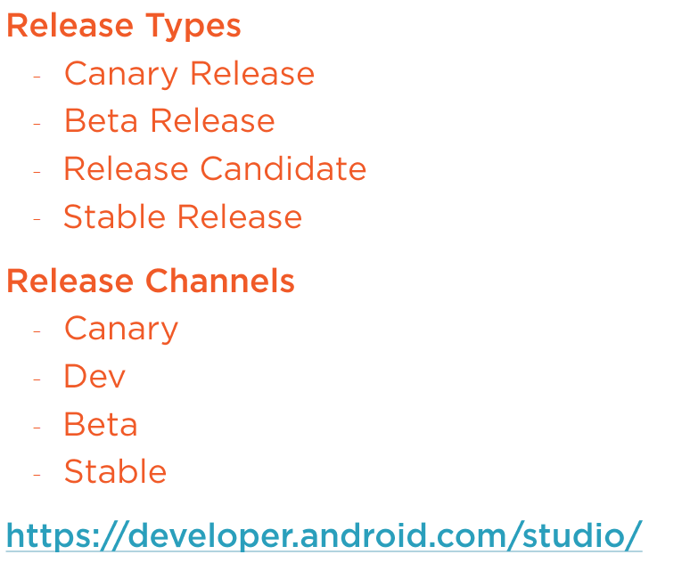
summary

